Slide 1

Bangalore Institute of Technology
M. Tech. In CSE
Department of Computer Science & Engineering
K.R. Road, V.V.Puram, Bangaluru-560 004
Sentimental Analysis of Users On Messages of Stock Market Forums
Presented by
Raghavendra Premanand Phayde
1BI18SCS07
II Sem M. Tech.
Under the guidance of
Prof. B. N. Shankar Gowda
Dept. of CS&E

Slide 2
Agenda
Introduction
Literature Survey
Problem Statement
Proposed System
SRS
Tools Used
Architecture
Modules
Implementation
Results
Conclusion
References

Slide 3
Introduction
Stocks
Represents fractional ownership of the corporation in proportion to the total number of shares.
Sentiment analysis
Sentiment Analysis is the process of ‘computationally’ determining whether a piece of writing is positive, negative or neutral. It’s also known as opinion mining, deriving the opinion or attitude of a speaker.

Slide 4
Applications of sentiment analysis
Business: In marketing field companies use it to develop their strategies, to understand customers feelings towards products or brand, how people respond to their campaigns or product launches and why consumers don’t buy some Products.
Public Actions: Sentiment analysis also is used to monitor and analyse social phenomena, for the spotting of potentially dangerous situations and determining the general mood of the blogosphere.

Slide 5
Literature Survey
Predicting Stock Movement using Sentimental Analysis of Twitter Feed, Pranjal Chakraborty, Ummay Sani Pria, Rashad Al Hasan Rony, Mahbub Alam Majumdar
Objective: Predicting Stock Movement from twitter tweets using Boosted Regression Tree Model

Slide 6
Architecture Diagram
Twitter tweets
Preprocessed data
Data Source
Data Preprocessing
Sentiment Analyzer
Sentiment score : Average Marginal
value of +ve and -ve tweets
Classifier
Marginal Value of tweets
For present day
Result
Predictor
Next day Stock Index Value

Slide 7
Limitation
Extremely high and extremely low stock indexes are cannot be predicted using Boosted Regression Tree.

Slide 8
Literature Survey
Using Sentimental Analysis in Prediction of Stock Market Investment, Sunil Kumar Khatri, Ayush Srivastava.
Objective: Predict the next day closing price of stock using Artificial Neural Network Model

Slide 9
Architecture Diagram
Raw Data
Twitter Data
Classifier
Polarity Index
(Happy, up, down, Rejected)
Stored in csv file
Artificial Neural Network
(Levenberg-Marquardt algorithm)
Graph shows which
company stock is good
Result

Slide 10
Limitation
Shorter period stock prices gives better Output

Slide 11
Literature Survey
Market Impact Analysis via Sentimental Transfer Learning, Xiaodong Li, Haoran Xie, Tak-Lam Wong and Fu Lee Wang
Objective: Transfer of sentiments from news-rich stocks to news-poor stocks from same sectors(e.g Commerce, Finance, Properties and Utilities) to improve the Prediction on Stocks

Slide 12
Limitation
Helpful only in increase the stock data of news-poor Stocks.
Adaption factors like stock price correlations need to be considered.
No methods are given to predict the stocks.

Slide 13
Literature Survey
Capital Market Forecasting By Using Sentimental Analysis, Rohan Srivastava, Soumil Agarwal, Dhruv Garg, Jagdish Chandra Patni
Objective: Predicting future stock price through various approches to give investors to better insights of next day trend.

Slide 14
Methodology
Exponential weighting.
Takes 10 days of data and assigns highest weight to the latest and lowest to oldest data.
Averaging the weighted data(closing price data).
KNN algorithm
Predicts next day price
Sentiment analysis on market data to ensure the prediction from Stock index data.

Slide 15
Limitation
Take too much time to give results as it consideres whole 10 days of datas

Slide 16
Literature Survey
Sentiment Analysis for Effective Stock Market Prediction, Shri Bharathi, Angelina Geetha.
Objective: To design and implement a predictive system for guiding stock market investment

Slide 17
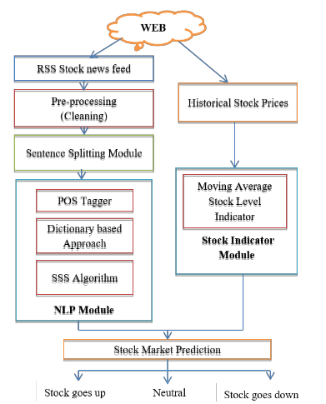
Architecture Diagram

Slide 18
Limitation
Rely on historical data, not considers real time data

Slide 19
Literature Survey
Random Forest and Support Based Hybrid The First International Conference on Vector Intelligent Machine Computing in Data Sciences Approach to Sentiment Analysis, Yassine AL AMRANI, Mohamed LAZAAR b , Analysis Kamal Eddine EL KADIRI.
Objective: Proposed an hybrid approch to identify products before purchasing it based on Random Forest Support Vector Machine(RFSVM).

Slide 20
Control Flow Diagram
Supervised Algorithms
Random
Forest
Database
Feature
Extraction
SVM
Evaluation
RFSVM

Slide 21
Limitation
Doesn’t give more weight to the real time reviews
Real time reviews provide more accurate information about product
Product may be performing better at present.

Slide 22
Literature Survey
Analysis of Various Sentiment Classification Techniques, Vimalkumar B. Vaghela, Bhumika M. Jadav
Objective: Proposed various classification algorithms to find sentiments.

Slide 23
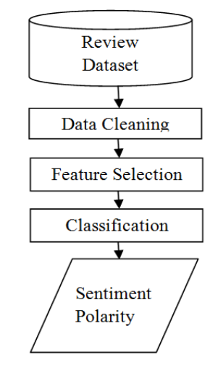
Process Flow Diagram

Slide 24
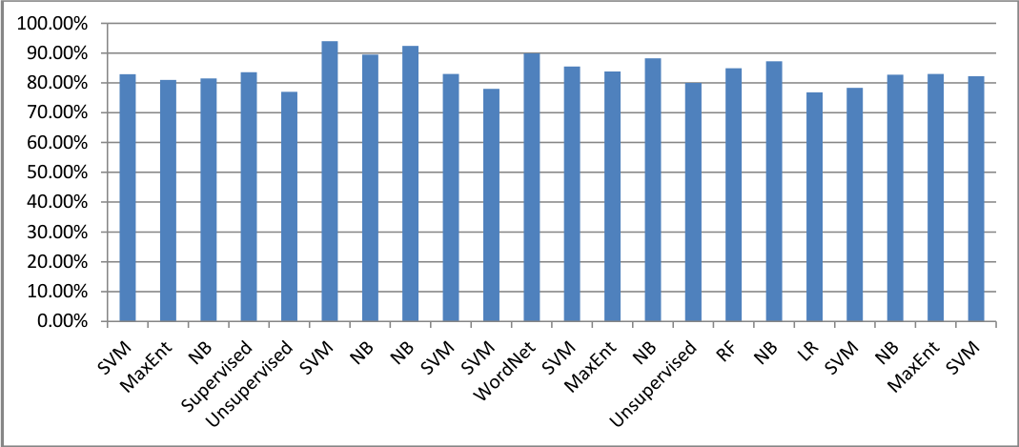
Accurancy Comaprision of classification techniques

Slide 25
Problem Statement
“To build an Application to predict Stock trend based on Investors reviews using Opinion Mining.”

Slide 26
Proposed System
Predict stock behaviour through real time Investors reviews.
Analyze the investors reviews to provide recommendation on Stocks of Companies.

Slide 27
SRS
Functional Requirement
Web Data Extraction.
Data Preprocessing.
Sentimental Analysis of comments of users.
Classification of sentiment data.

Slide 28
SRS
Non Functional Requirement
Availability
Application must be available to Users
Reliability
Application must provide Reliable result to users.

Slide 29
Tools Required
1. python IDE
2. nltk(Natural Language ToolKit)
- wordnet
- Vader Sentiment Analyzer
3. selenium
3. pandas

Slide 30
Architectural Diagram
Unstructured Data
Semi Structured Data
Data Source
Data Extraction
Data Pre Processing
Structured Data
Result
Classifier
Sentiment Analysis
CSV file
Rating

Slide 31
Modules
Data Extraction
Data Preprocessing
Sentimental Analysis
Classifier
Result

Slide 32
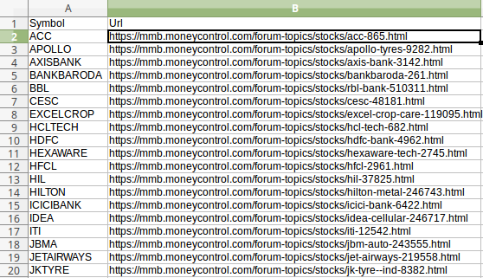
Data Source:UrlList.csv

Slide 33
Required Data: Potential keywords used to identify trustworthy sentences
lists = [
'Agent', 'Ask/Offer', 'Assets', 'At the money', 'Bear Marke',
'Beta', 'Bid', 'Blue Chip Stock', 'Board Lot', 'Bonds:',
'Book', 'Broker/Brokerage Firm', 'Bull Market',
'Business Day', 'Call Option', 'Close Price', 'Commodities', 'Convertible Securities', 'Debentures', 'Defensive Stock',
'Delta', 'Derivatives', 'Diversification', 'Dividend', 'Equity', 'Bear Market', 'Beta', 'Blue Chip Stocks', 'Bourse', 'Broker','Bid', 'Close', 'Day Trading', 'Dividend', 'High', 'Index', 'Leverage', 'Low', 'Margin', 'Moving Average', 'Open', 'Order', 'Portfolio', 'Quote', 'Rally', 'Sector',
'Share Market', 'Short Selling', 'Spread', 'Stock Symbol', 'Volatility', 'Volume', 'Yield‘
]

Slide 34
Data Extraction
Tool Used : Selenium
Online extraction :
In Online extraction the data is extracted directly from the source system.
The extraction process connects to the source system and extracts the source data.
Source : https://mmb.moneycontrol.com/forum-topics/stocks/company_name.html

Slide 35
Pseudo Code:
browser = webdriver.Chrome('/home/raghu/Pictures/chromedriver')
for j in range(len(df)):
print("Browser Opened")
browser.get(df.loc[j, "Url"])
print (df.loc[j, "Symbol"],”Company Forum loaded on browser”)
time.sleep(random.randint(5, 10))
print("Scroll to y=2000 axis down")
browser.execute_script("window.scrollTo(0, 2000)")
time.sleep(random.randint(5, 10))
print("Testing stop")
alldata = []
allData = browser.find_elements_by_class_name("rht_content")
print(allData)

Slide 36
Pseudo Code
comments = []
dates = []
for i in allData:
comment = i.find_element_by_class_name("txt16gry")
#print(comment)
date = i.find_element_by_class_name("link13gry")
#print(date)
try:
c = comment.find_element_by_tag_name('a')
comments.append(c.text)
dates.append(date.text)
except:
print ("No Recommendation.")
continue

Slide 37
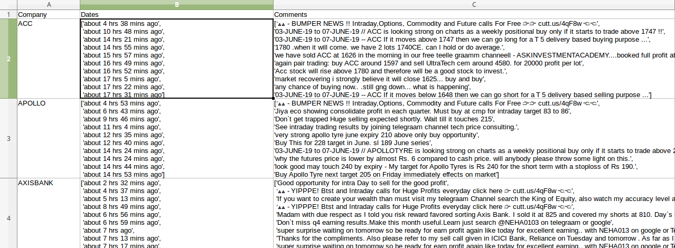
After Data Extraction
Result data type : semi structured data
File name : Semi_structured.csv

Slide 38
Data Preprocessing
Selecting only specified date
for i in dates:
if i.find("about") != -1 or i.find("June 6th")
Dates.append(i)
for i in range(len(Dates)):
Comments.append(comments[i])
This code removes all other comments of having different date.

Slide 39
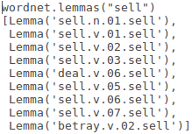
Data Preprocessing
Tools used :
nltk(Natural Language Toolkit)
Wordnet
Lemmas(keyword) : words having
All lemmas of keyword
e.g
This will modify our predefined keyword. Now it includes its keywords along with its lemmas

Slide 40
Sentimental Analyzer
Sentences are selected only if atleast one of the predefined keyword is present.
Sentiment scores is calculated for selected sentences athrough SentimentIntensityAnalyzer.
Scores are called polarity scores
For each keyword the polarity scores are calculated

Slide 41
Sentiment Analyzer
Rating is given based on
If sentence is positive then rating of that keyword is incremented
If not then it is a negative sentence hence ratings of that keyword decremented.
Ratings of all keyword calculated.

Slide 42
Classifier
Now the system selects all positive/negative/neutral keyword and their ratings are added.
If a company has more positive rating then its stock can be brought.
If a company has more negative rating then stock can be sold.
Otherwise hold the stocks.

Slide 43
Results
Results of Application is stored in CSV file
File name : Result_final.csv

Slide 44
Methodology
1.Connect to the website by selenium tool
2.Scrap the webpages having unstructured data through selenium tool to get semi structured data.
3.Parse these semi structured data to get Data relevent to the Application.
4.Classify each comments as positive, negative or neutral.
5. Apply Sentiment Analysis on refined data to get score which determines which is best choice(buy,sell,hold) for stocks.
6. Provide Result in CSV file

Slide 45
Selenium Result:
[<selenium.webdriver.remote.webelement.WebElement (session="48065de2f4fe081d944e4dc12a1b67ee", element="0.34928147231093387-1")>, <selenium.webdriver.remote.webelement.WebElement (session="48065de2f4fe081d944e4dc12a1b67ee", element="0.34928147231093387-2")>, <selenium.webdriver.remote.webelement.WebElement (session="48065de2f4fe081d944e4dc12a1b67ee", element="0.34928147231093387-3")>, <selenium.webdriver.remote.webelement.WebElement (session="48065de2f4fe081d944e4dc12a1b67ee", element="0.34928147231093387-4")>, <selenium.webdriver.remote.webelement.WebElement (session="48065de2f4fe081d944e4dc12a1b67ee", element="0.34928147231093387-5")>, <selenium.webdriver.remote.webelement.WebElement (session="48065de2f4fe081d944e4dc12a1b67ee", element="0.34928147231093387-6")>]

Slide 46
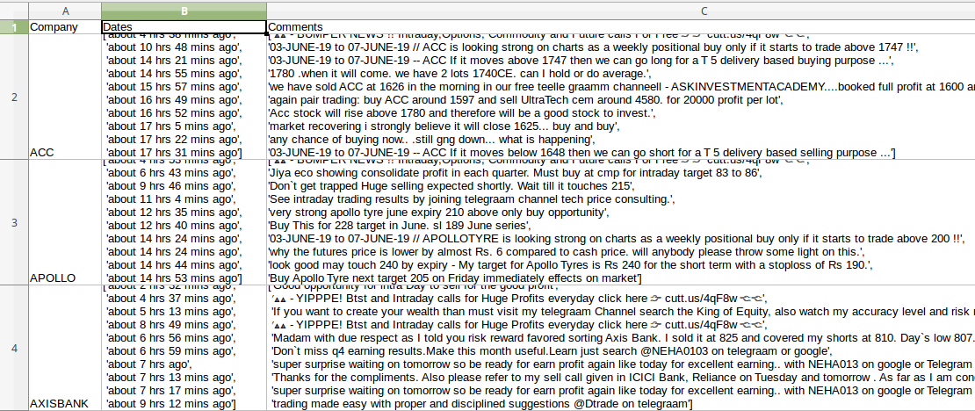
Semi Structured output

Slide 47
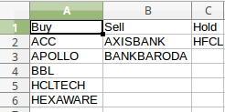
Result

Slide 48
Conclusion
Predicts future movement of stocks through analyzing sentiments of reviews given by investors in stock market forum.

Slide 49
References
Pranjal Chakraborty, Ummay Sani Pria, Md. Rashad Al Hasan Rony, Mahbub Alam Majumdar, “Predicting Stock Market Using Sentiment Analusis of Twitter feed”, IEEE Conferences,pp. 1-6, 2017.
Sunil Kumar Khatri, Ayush Srivastava, “Using Sentimental Analysis in Prediction of Stock Market Investment”, IEEE Conferences, pp. 566-569, 2016.
Xiaodong Li, Haoran Xie, Tak-Lam Wong and Fu Lee Wang, “Market Impact Analysis via Sentimental Transfer Learning”, IEEE Conferences, pp: 451-452, 2017.
Rohan Srivastava ; Soumil Agarwal ; Dhruv Garg ; Jagdish Chandra Patni, “Capital market forecasting by using sentimental analysis”, IEEE Conferences, pp: 09-12, 2016.

Slide 50
References
Shri Bharathi, Angelina Geetha,”Sentiment Analysis for Effective Stock Market Prediction”, IEEE Conferences,2017.
Yassine AL AMRANI, Mohamed LAZAAR b , Analysis Kamal Eddine EL KADIRI,”Random Forest and Support Based Hybrid The First International Conference on Vector Intelligent Machine Computing in Data Sciences Approach to Sentiment Analysis”,IEEE Conferences,2018.
Vimalkumar B. Vaghela, Bhumika M. Jadav, “Analysis of Various Sentiment Classification Techniques”,IEEE Conferences, 2018.

